Slide 1

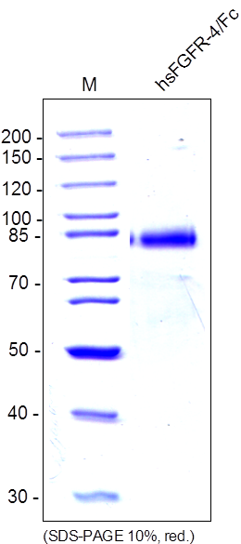
ReliaTech GmbH
Recombinant human sFGFR-4/Fc Chimera
(Cat #SFC-021 / SFC-022 )
Fig. 1: SDS-PAGE analysis of recombinant human soluble FGFR-4/Fc Chimera produced in insect cells. Sample was loaded in 10% SDS-polyacrylamide gel under reducing conditions and stained with Coomassie blue.
http://www.reliatech.de / orders@reliatech.de

